Slide 1

HANDWRITTEN DIGIT RECOGNITION
PRESENTED BY: Batch-13 INTERNAL GUIDE:
18311A0589 – K.V. REBEKAH P. DURGA PRASAD
18311A0597 – M. VAMSHI KRISHNA PROJECT COORDINATOR:
18311A0599 – M. SHREYA P. DURGA PRASAD
HEAD OF THE DEPARTMENT: Dr. ARUNA VARANASI

Slide 2
ABSTRACT
The handwritten digit recognition is the ability of computers to recognize human handwritten digits. It is a hard task for the machine because handwritten digits are not perfect and can be made with many different flavours. The handwritten digit recognition is the solution to this problem which uses the image of a digit and recognizes the digit present in the image.
Digit Recognition is a noteworthy and important issue. As the manually written digits are not of a similar size, thickness, position and direction, in this manner, various difficulties must be considered to determine the issue of handwritten digit recognition. The uniqueness and assortment in the composition styles of various individuals additionally influence the example and presence of the digits. It is the strategy for perceiving and arranging transcribed digits.

Slide 3
INTRODUCTION
Humans can see and visually sense the world around them by using their eyes and brain. Computer vision works on enabling computers to see and process images in the same way that human vision does. Several algorithms are developed in the area of computer vision to recognize images.
The goal of our work will be to create a model that will be able to identify and determine the handwritten digit from its image with better accuracy. We aim to complete this by using the concepts of Convolutional Neural Network and MNIST dataset.
Though the goal is to create a model which can recognize the digits, we can extend it for letters and then a person’s handwriting. Through this work, we aim to learn and practically apply the concepts of Convolutional Neural Networks.

Slide 4
SOFTWARE REQUIREMENTS
Operating System: Windows 8 or higher
Tools or Software: MNIST Dataset
Google Collaboratory

Slide 5
HARDWARE REQUIREMENTS
Processor: Intel i3 or higher RAM: 4GB or higher
Hard Disk: SSD-256GB or above HDD-516GB or higher
Internet Speed: Preferably 50Mbps or higher

Slide 6
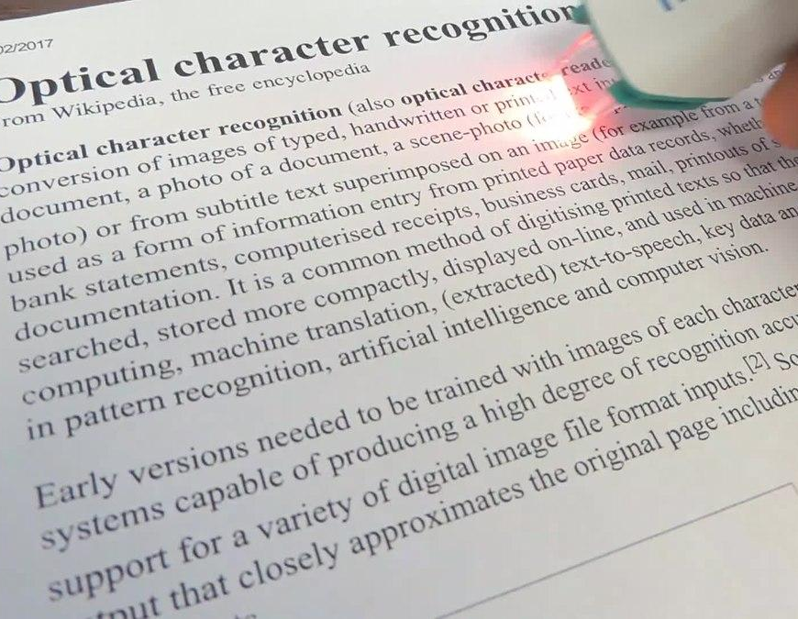

EXISTING SYSTEM
Optical Character Recognition
OCR text works efficiently with the printed text only and not with handwritten text. Handwriting must be learnt by the PC.
OCR systems are expensive.
There is the need of lot of space required by the image produced.

Slide 7

PROPOSED SYSTEM
Convolutional Neural Network
MNIST dataset, Tensorflow, Keras
PROCESS: Load Dataset
CNN Design
Pre-processing(Normalisation)
Training phase
Testing
Classification

Slide 8
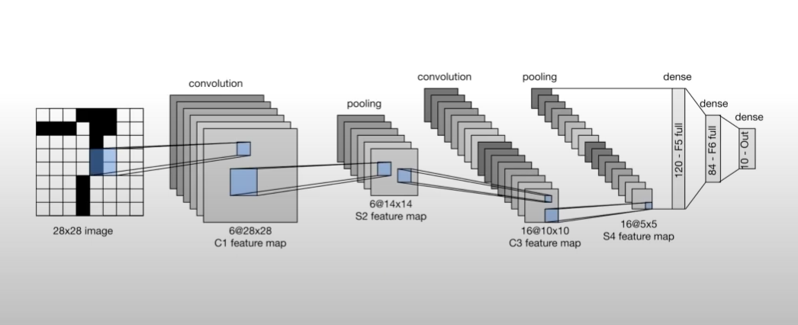
ARCHITECTURE DIAGRAM

Slide 9
UML DIAGRAMS

Slide 10
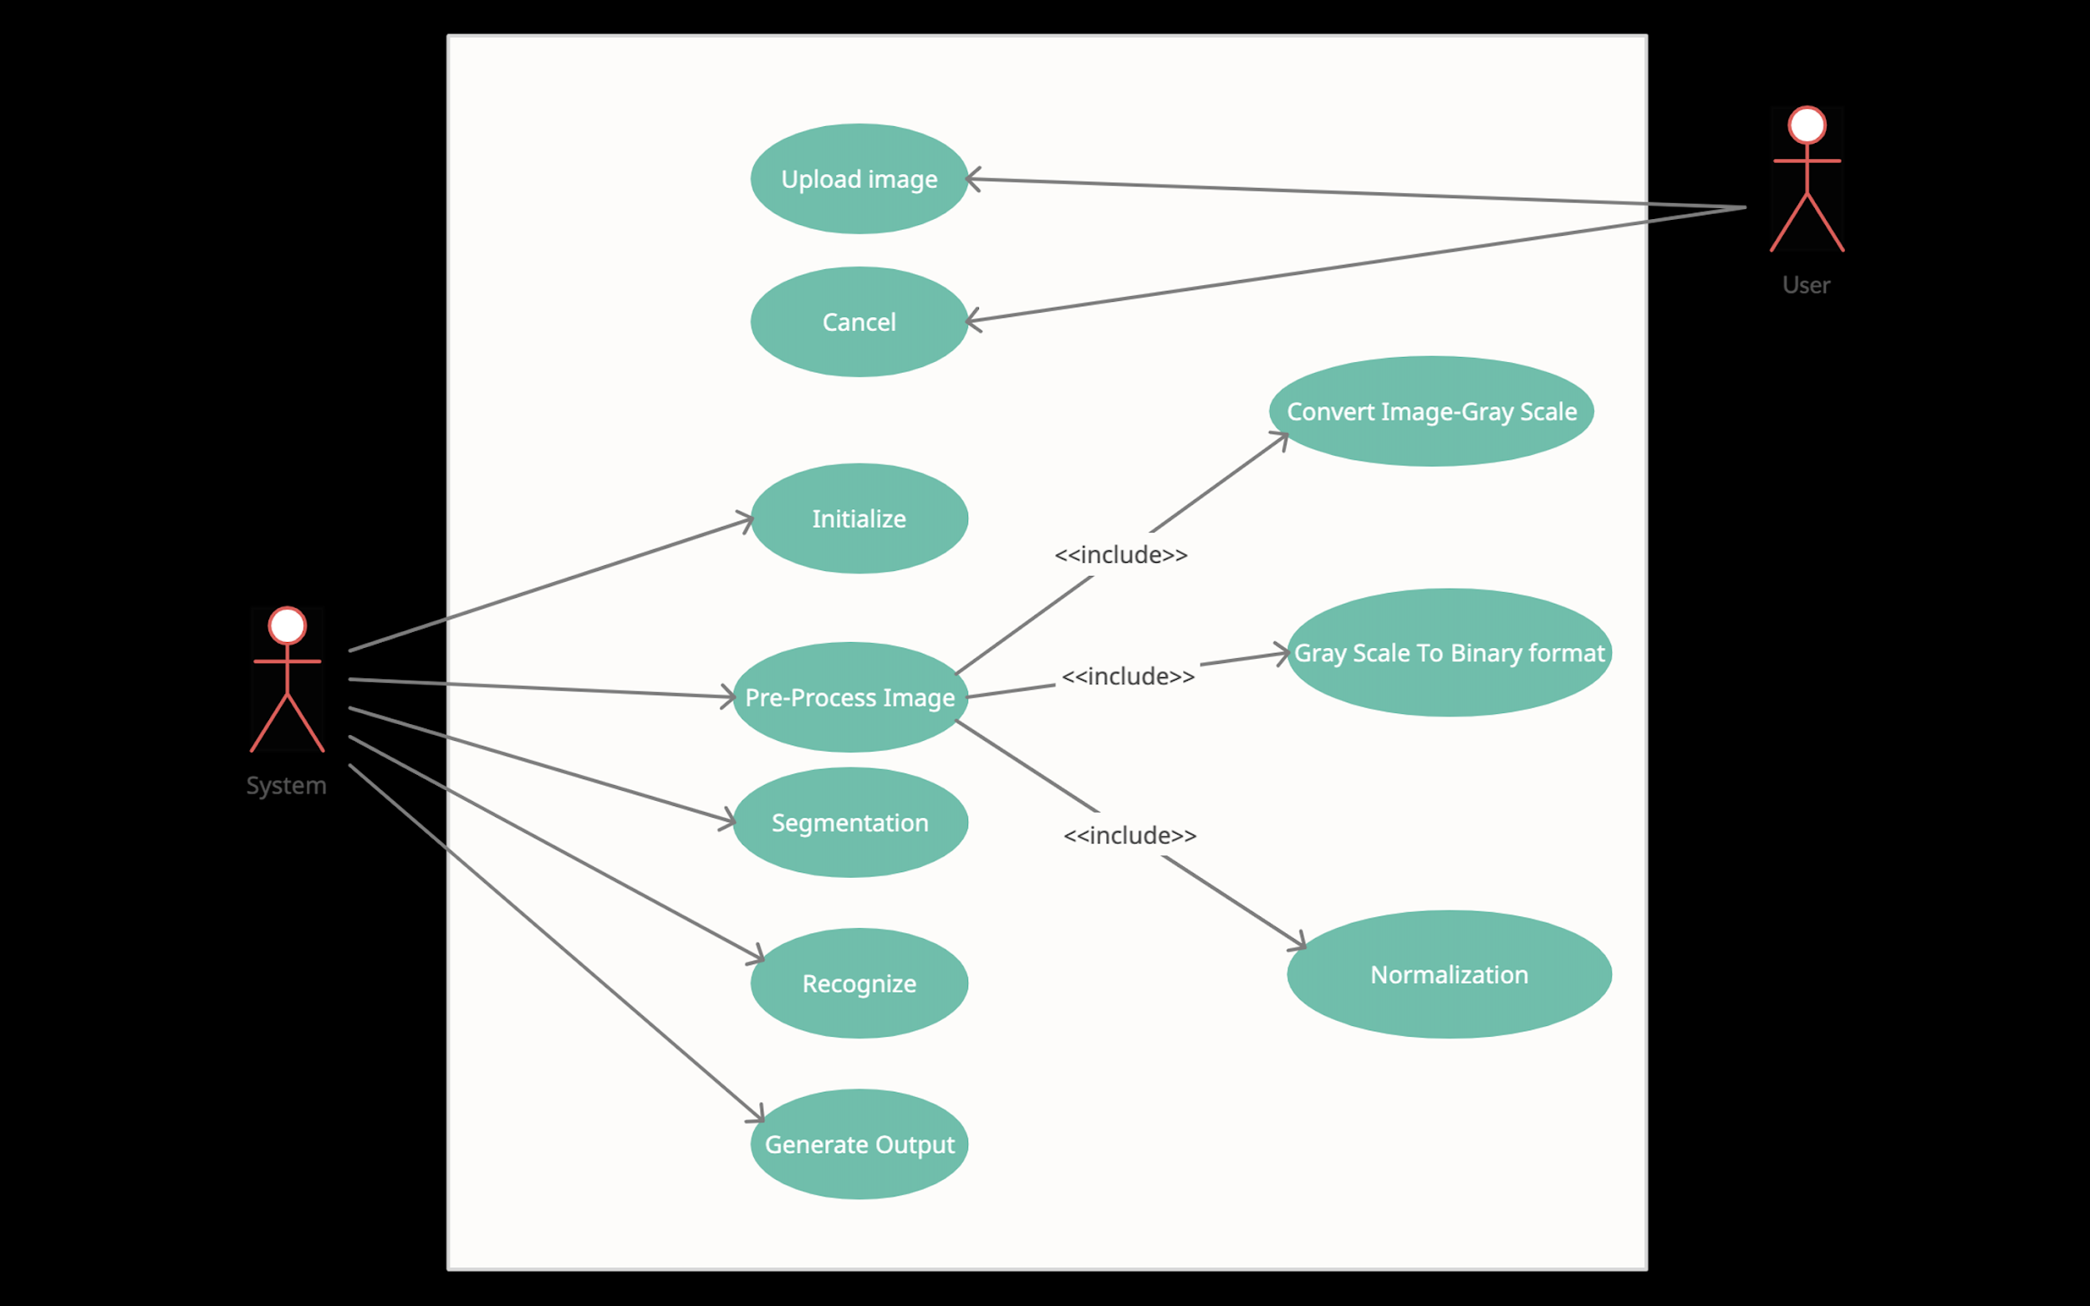
USE CASE DIAGRAM

Slide 11
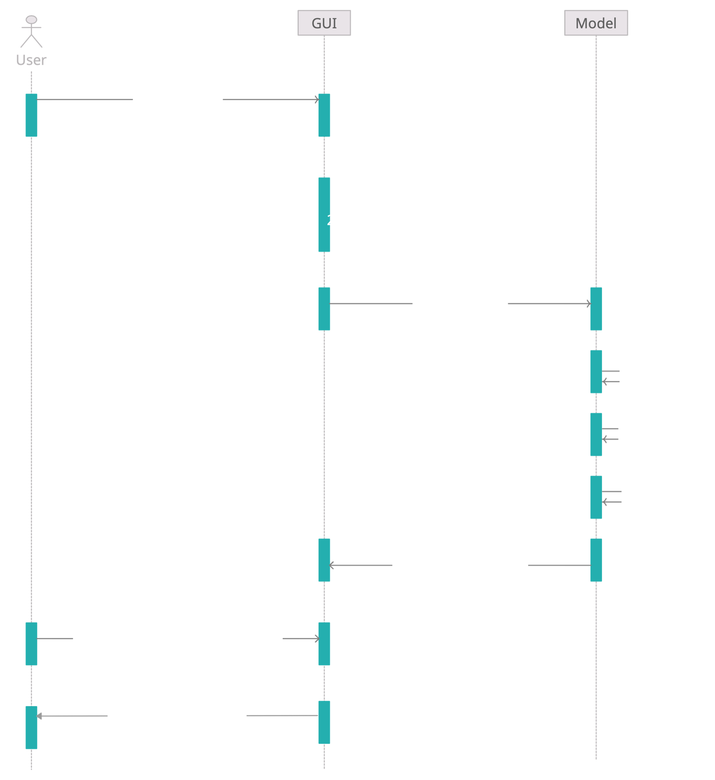
SEQUENCE DIAGRAM

Slide 12
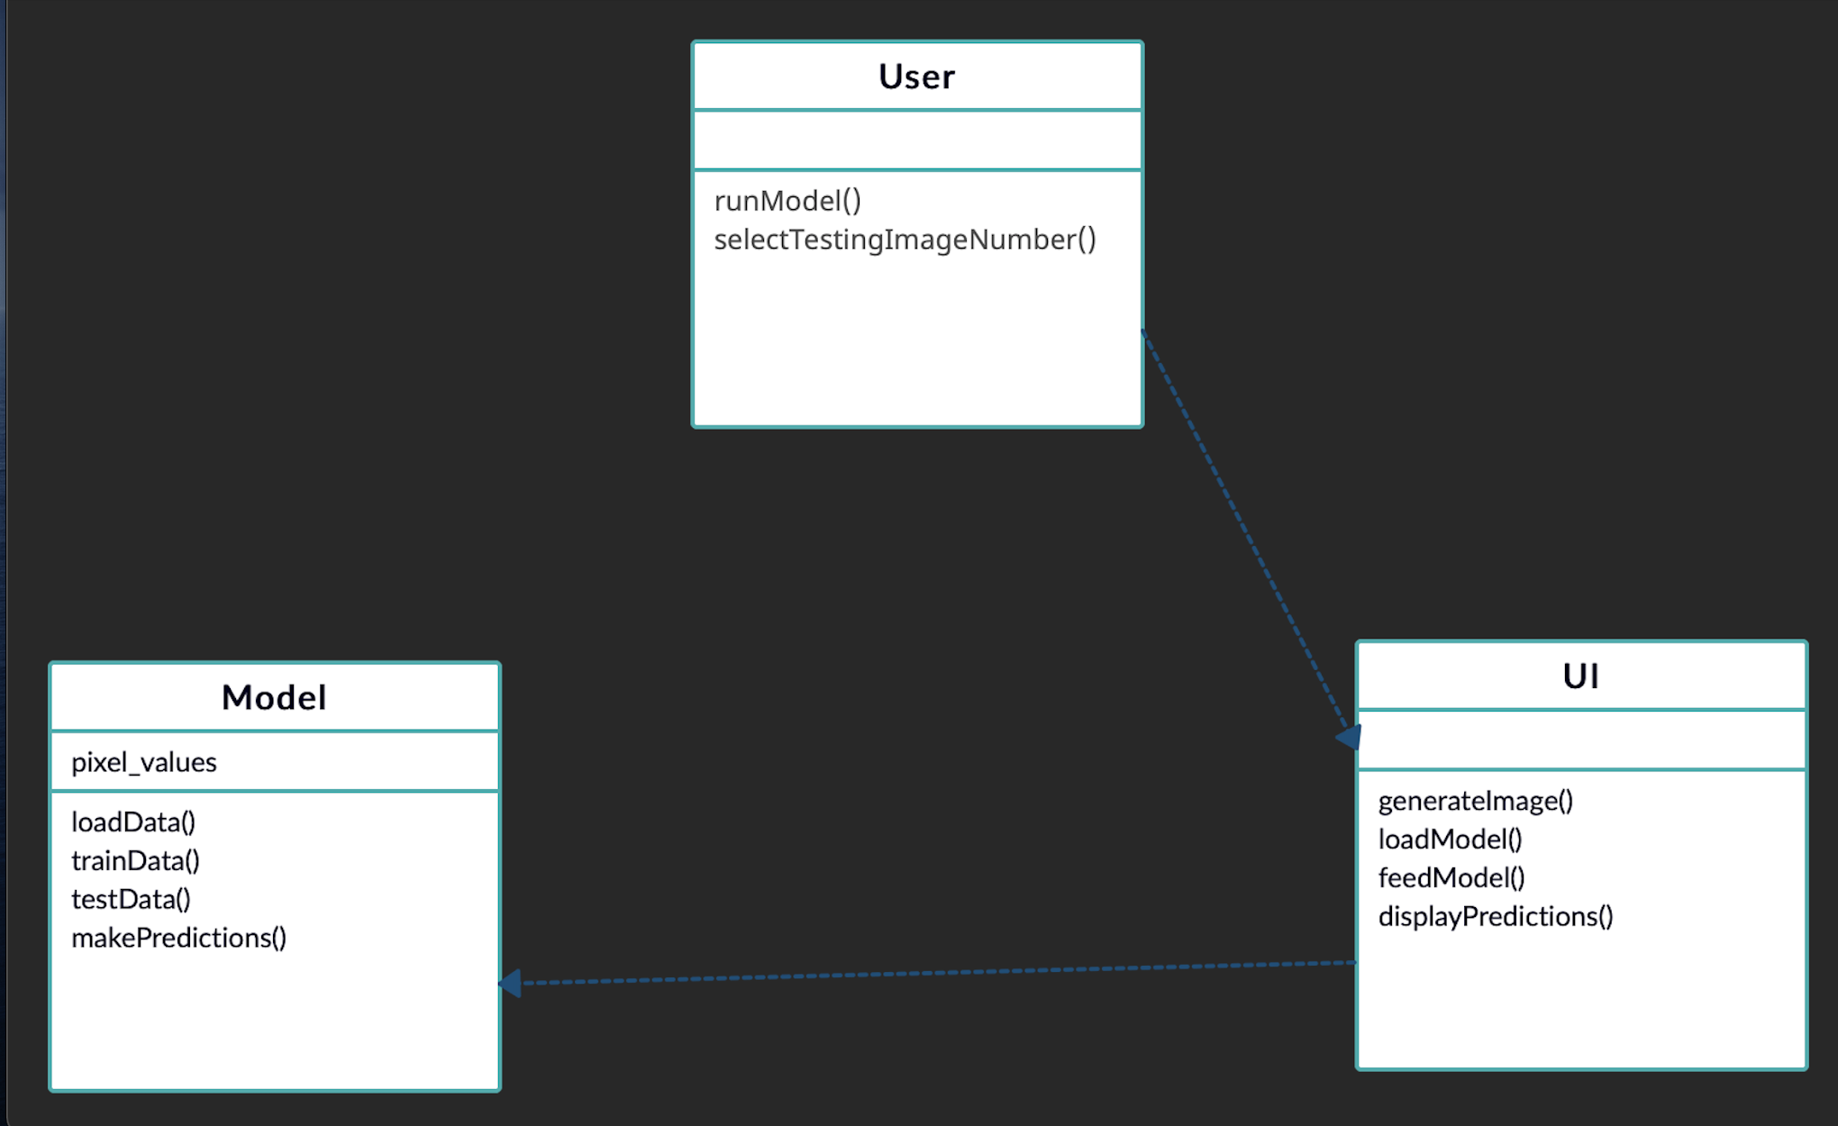
CLASS DIAGRAM

Slide 13
IMPLEMENTATION

Slide 14
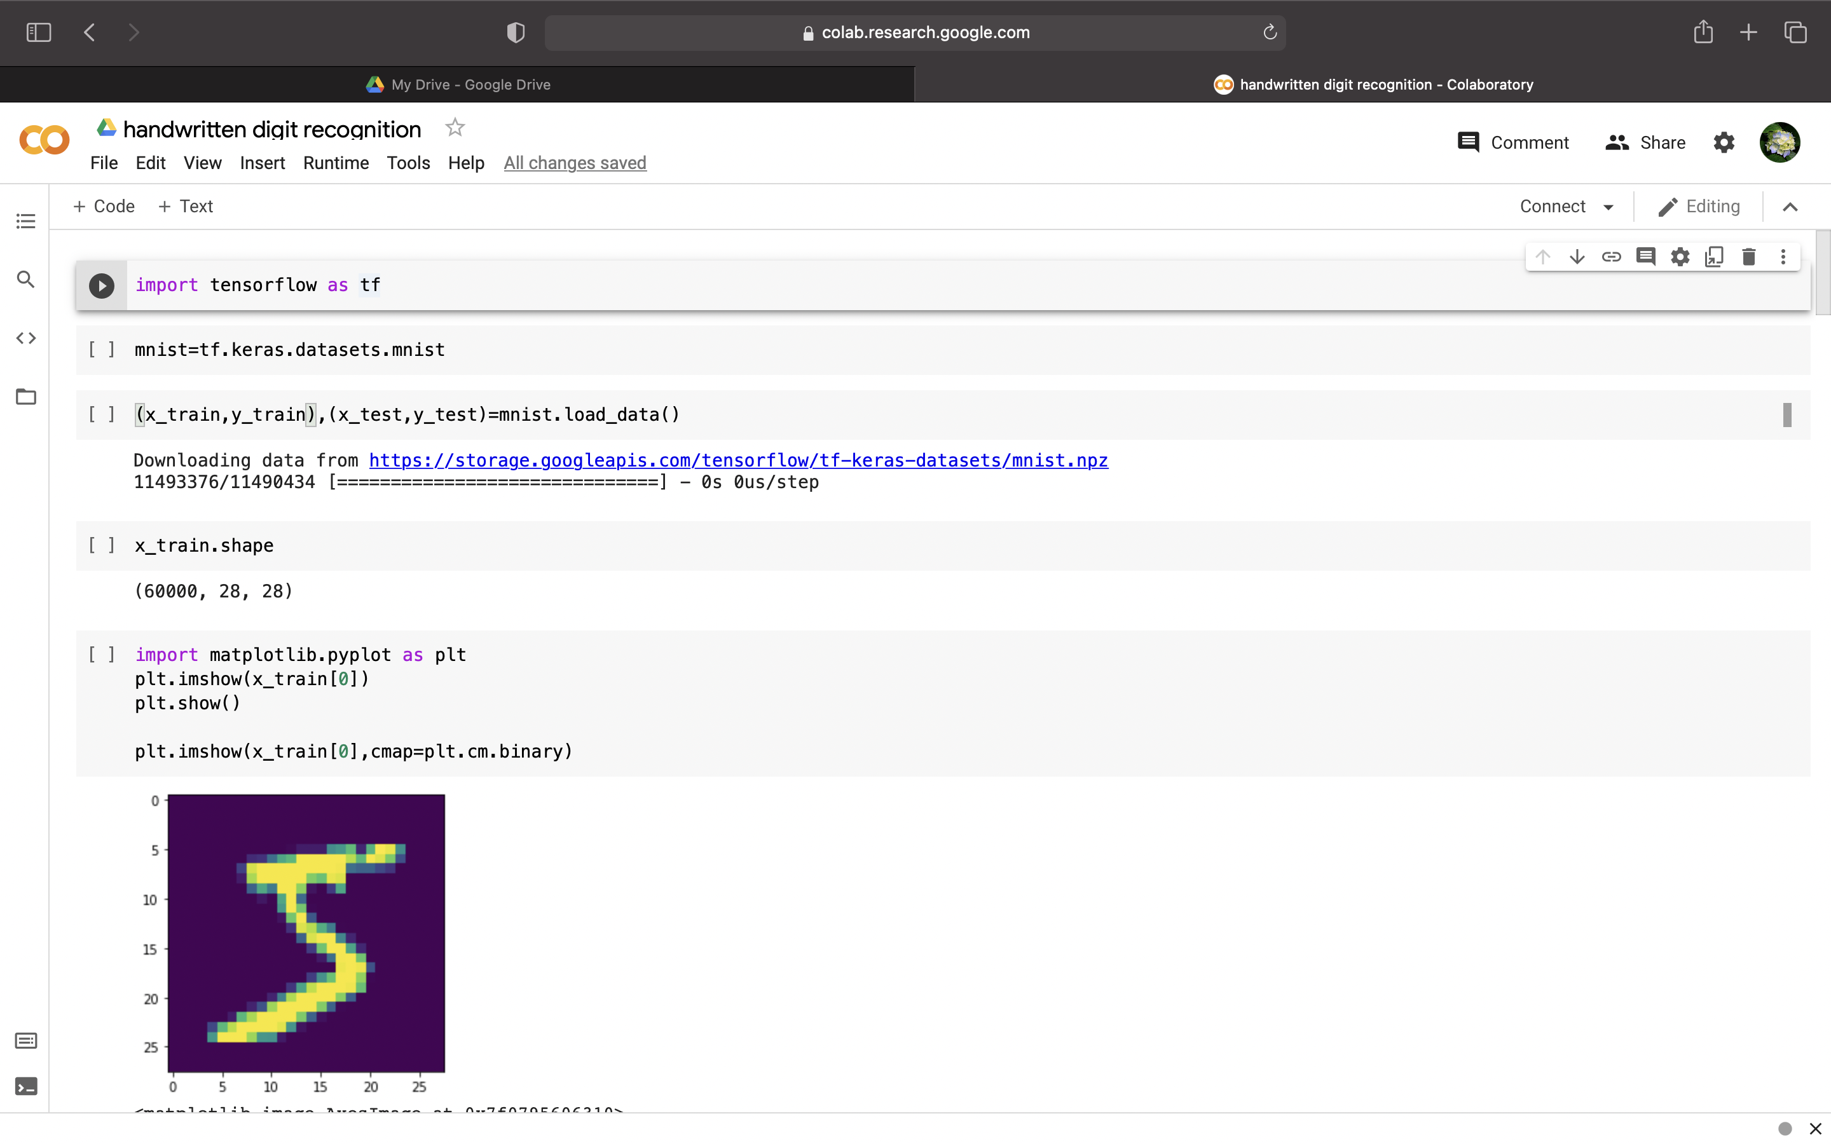

Slide 15
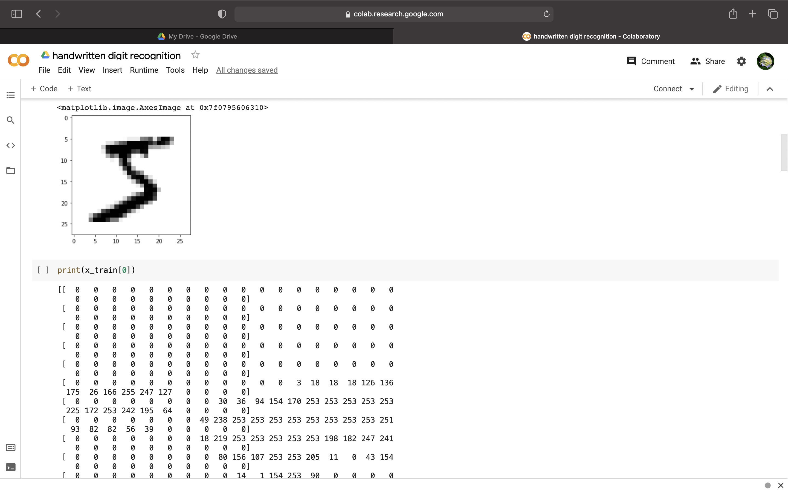

Slide 16
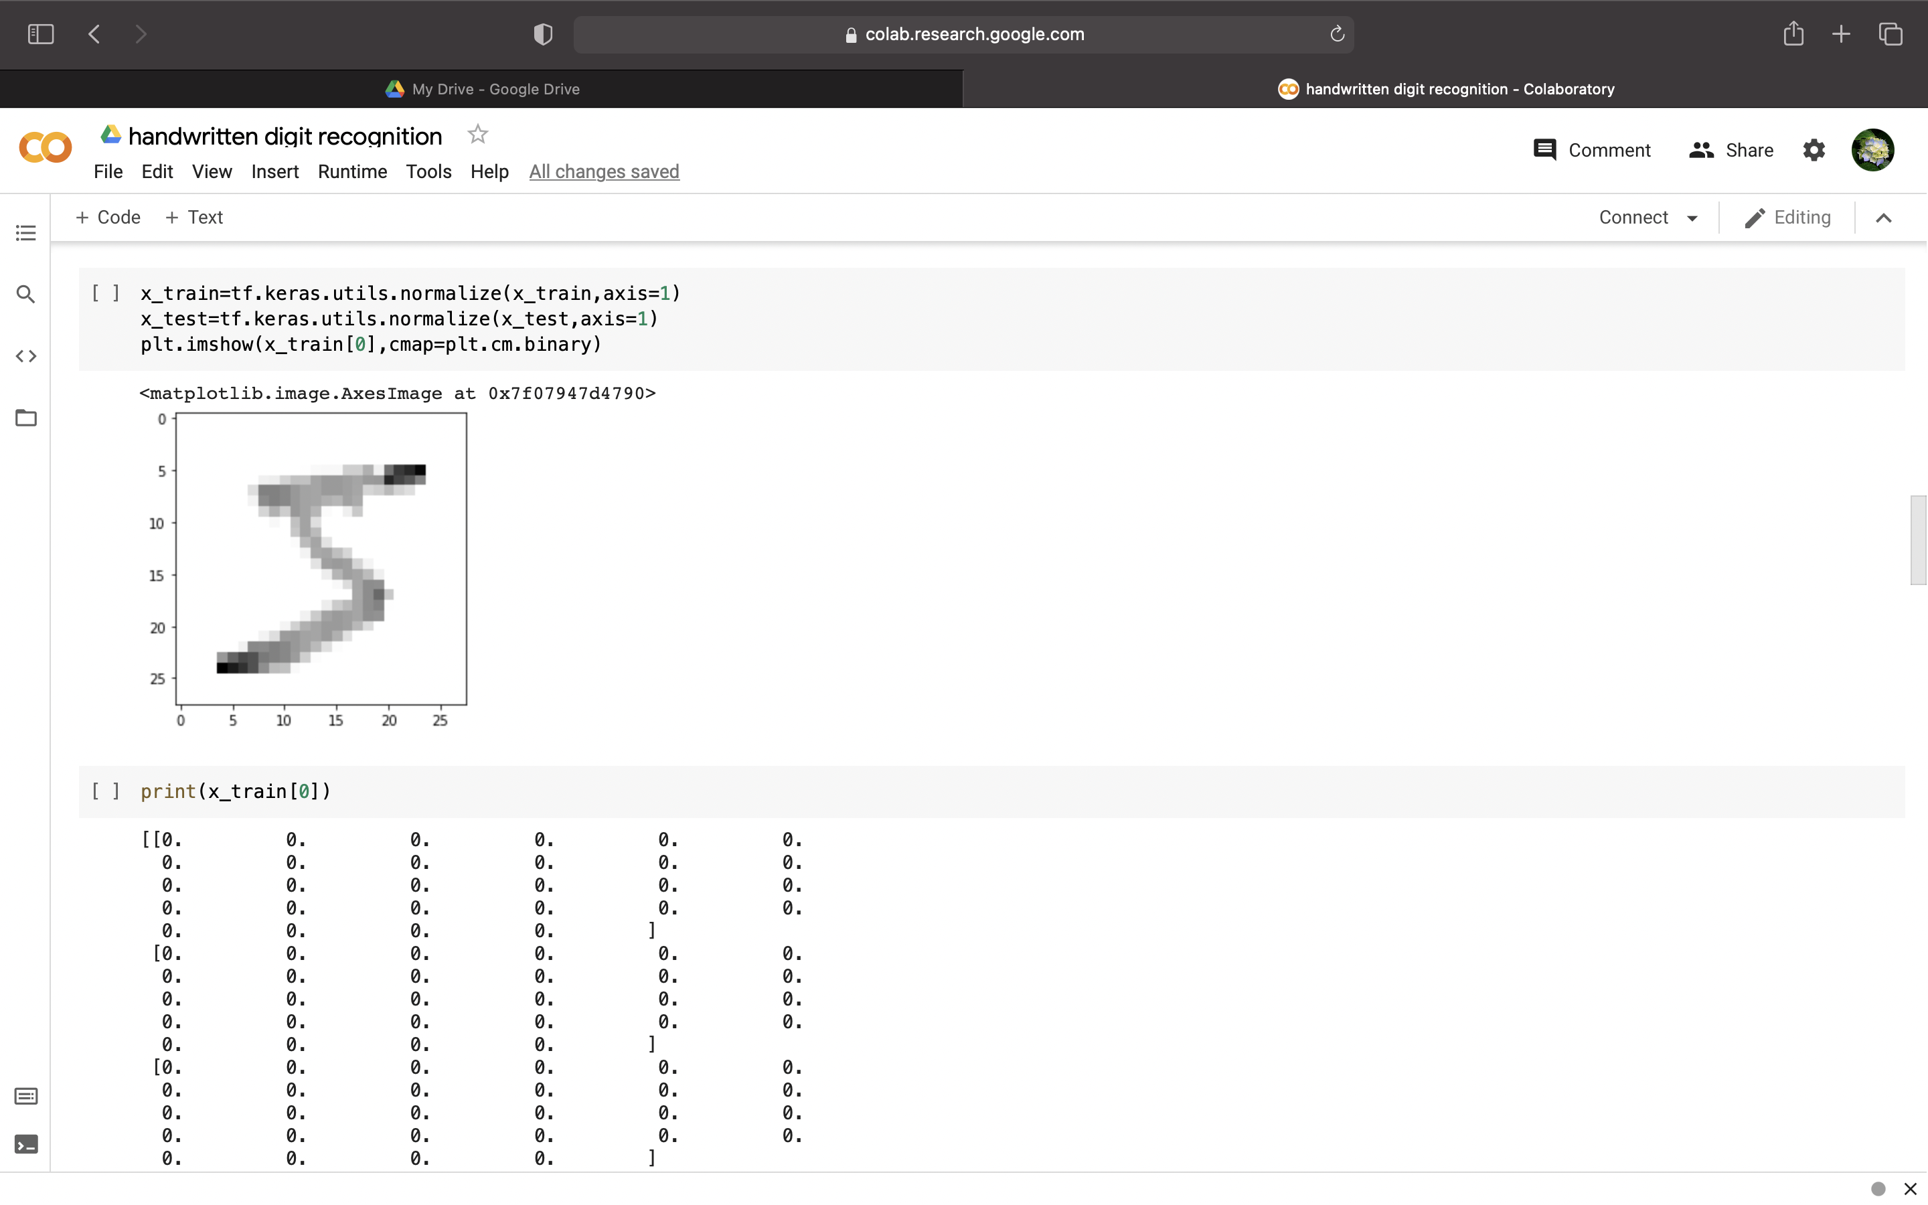

Slide 17
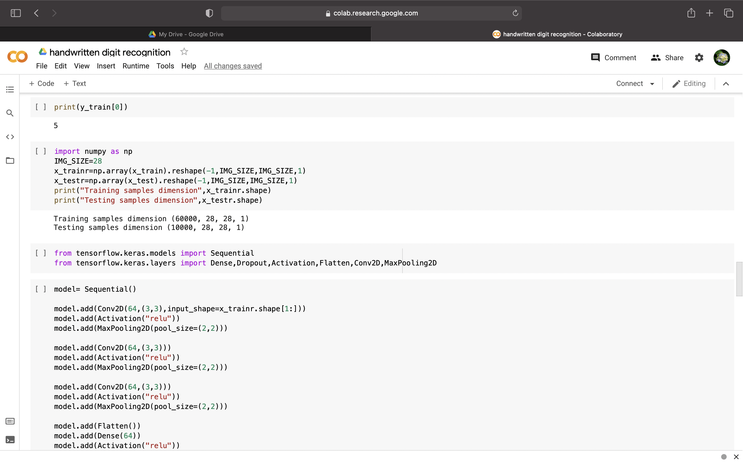

Slide 18
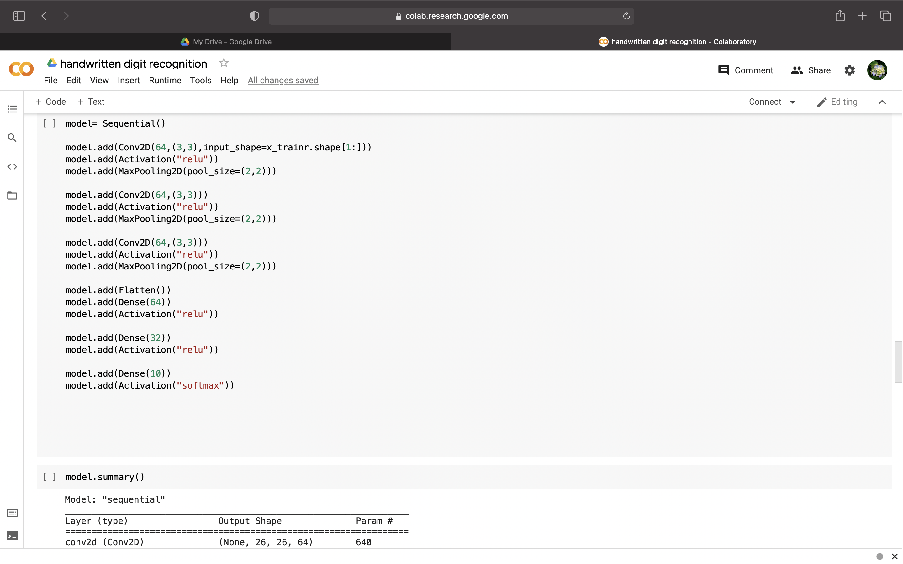

Slide 19
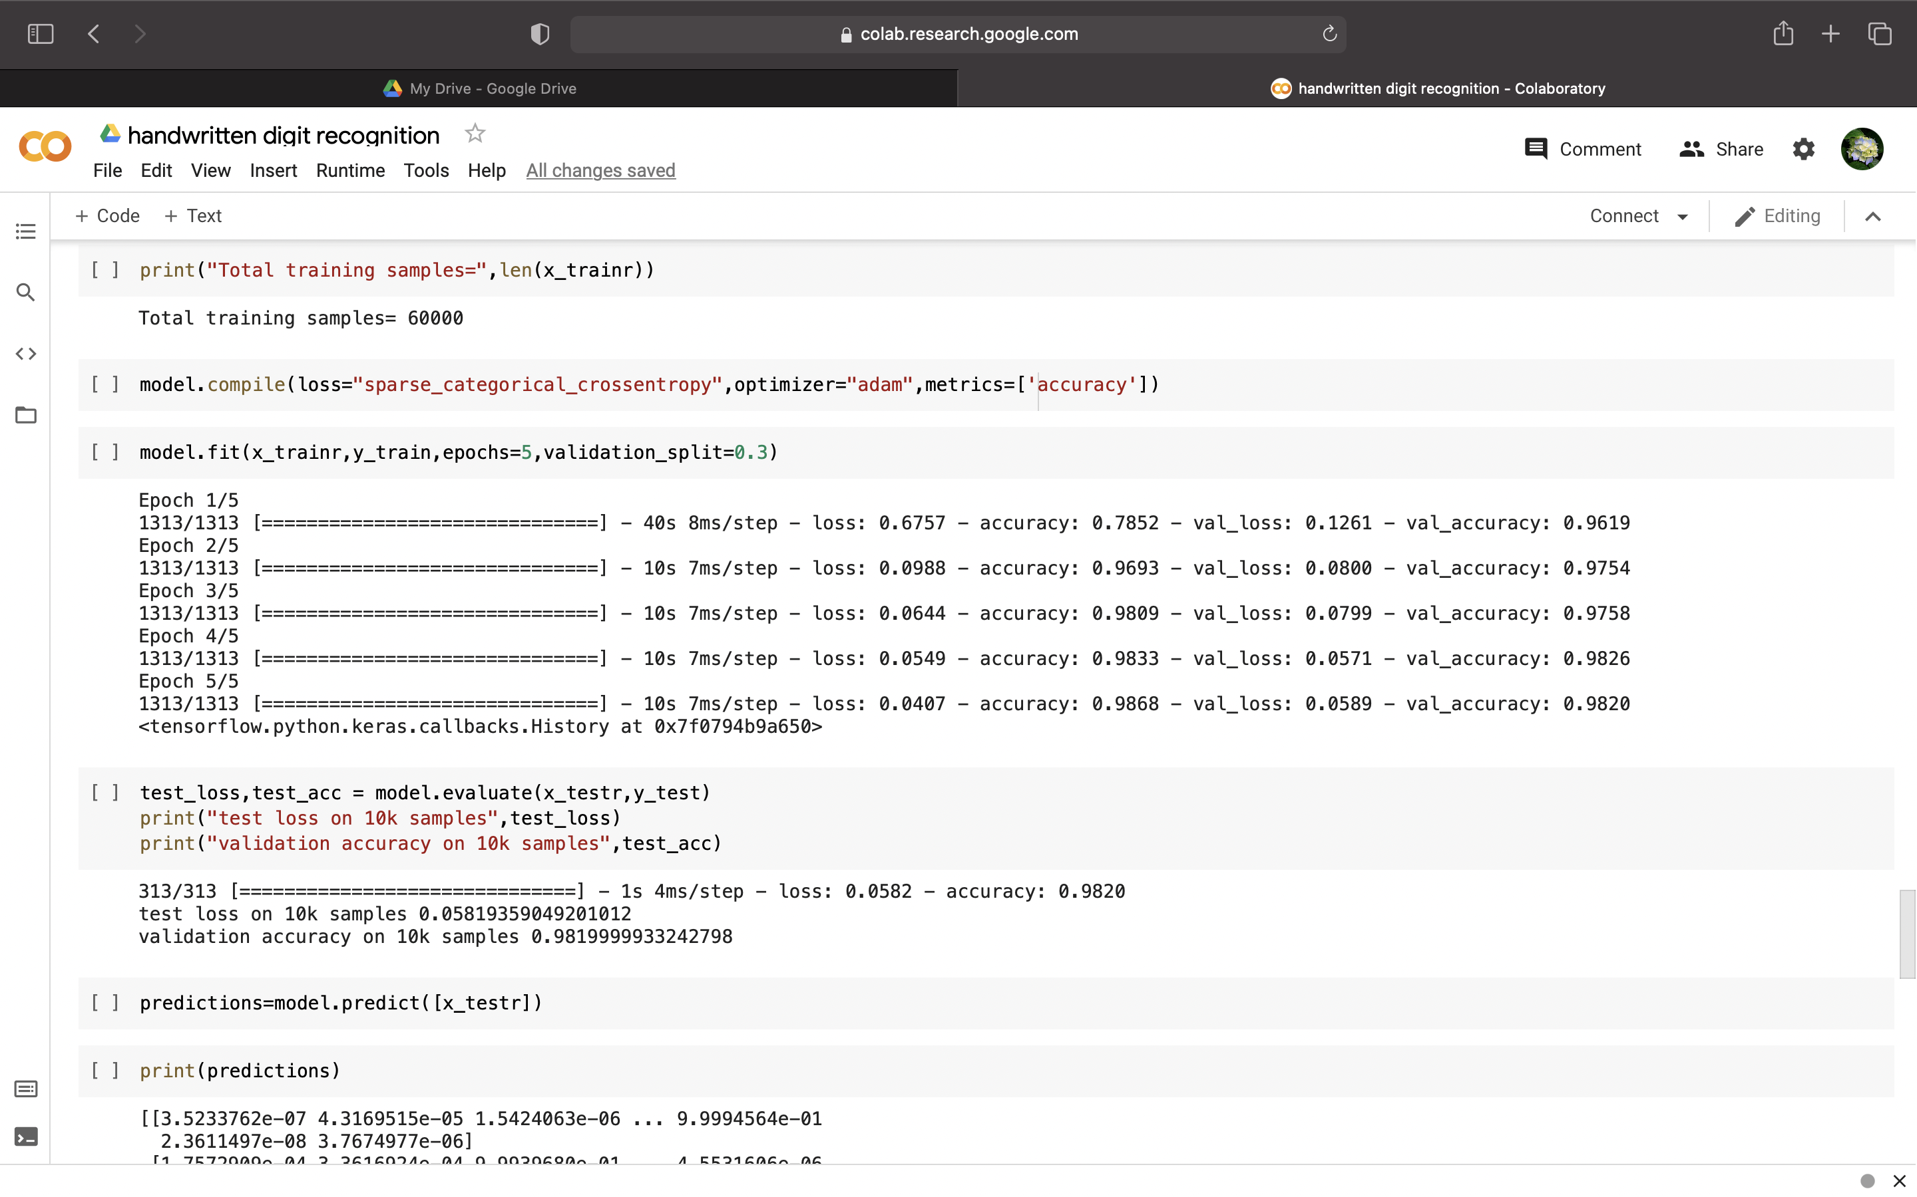

Slide 20
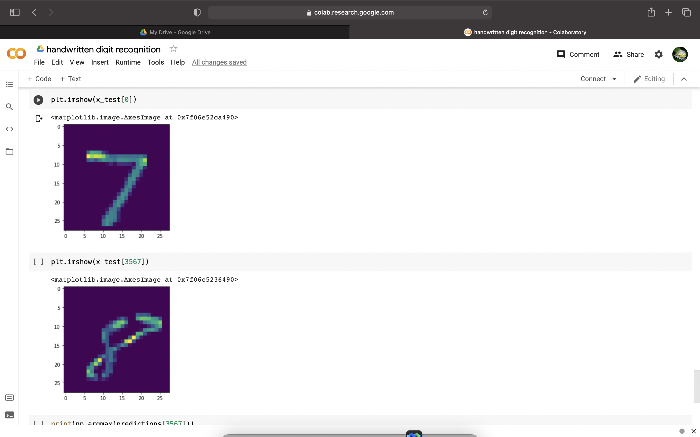

Slide 21
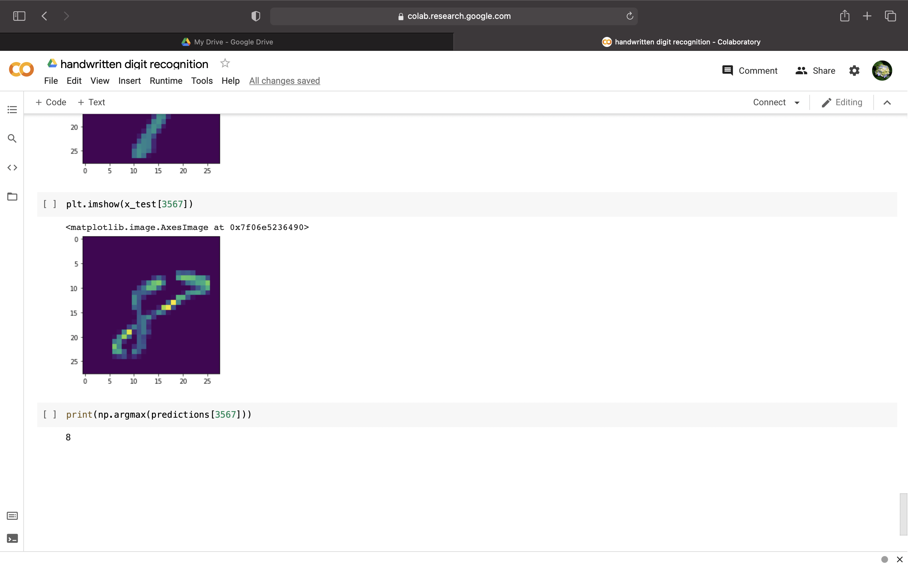

Slide 22
CONCLUSION
In this project, the Handwritten Digit Recognition using Deep learning methods has been implemented. Utilizing these deep learning techniques, a high amount of accuracy can be obtained. Compared to other research methods, this method focuses on which classifier works better by improving the accuracy of classification models by more than 99%. Using Keras as backend and TensorFlow as the software, a CNN model is able to give accuracy of about 98.72%.

Slide 23
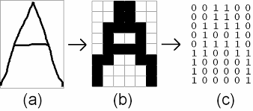
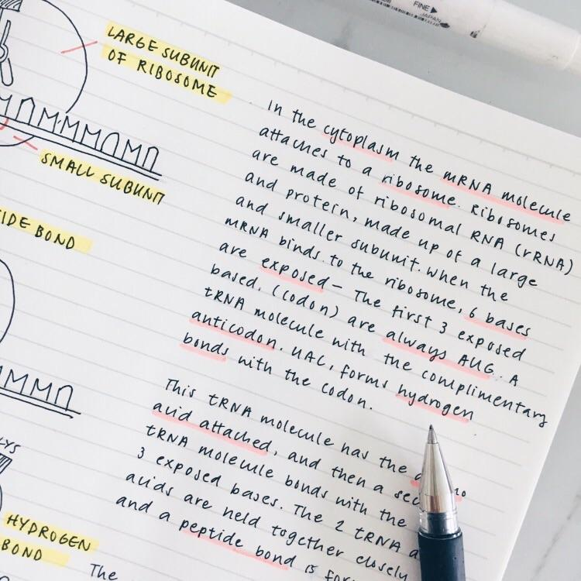
FUTURE ENHANCEMENTS
Character Recognition

Slide 24
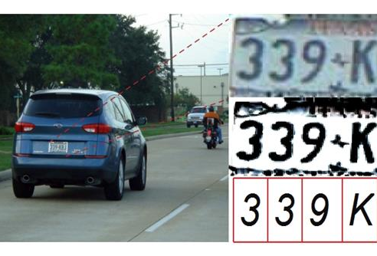
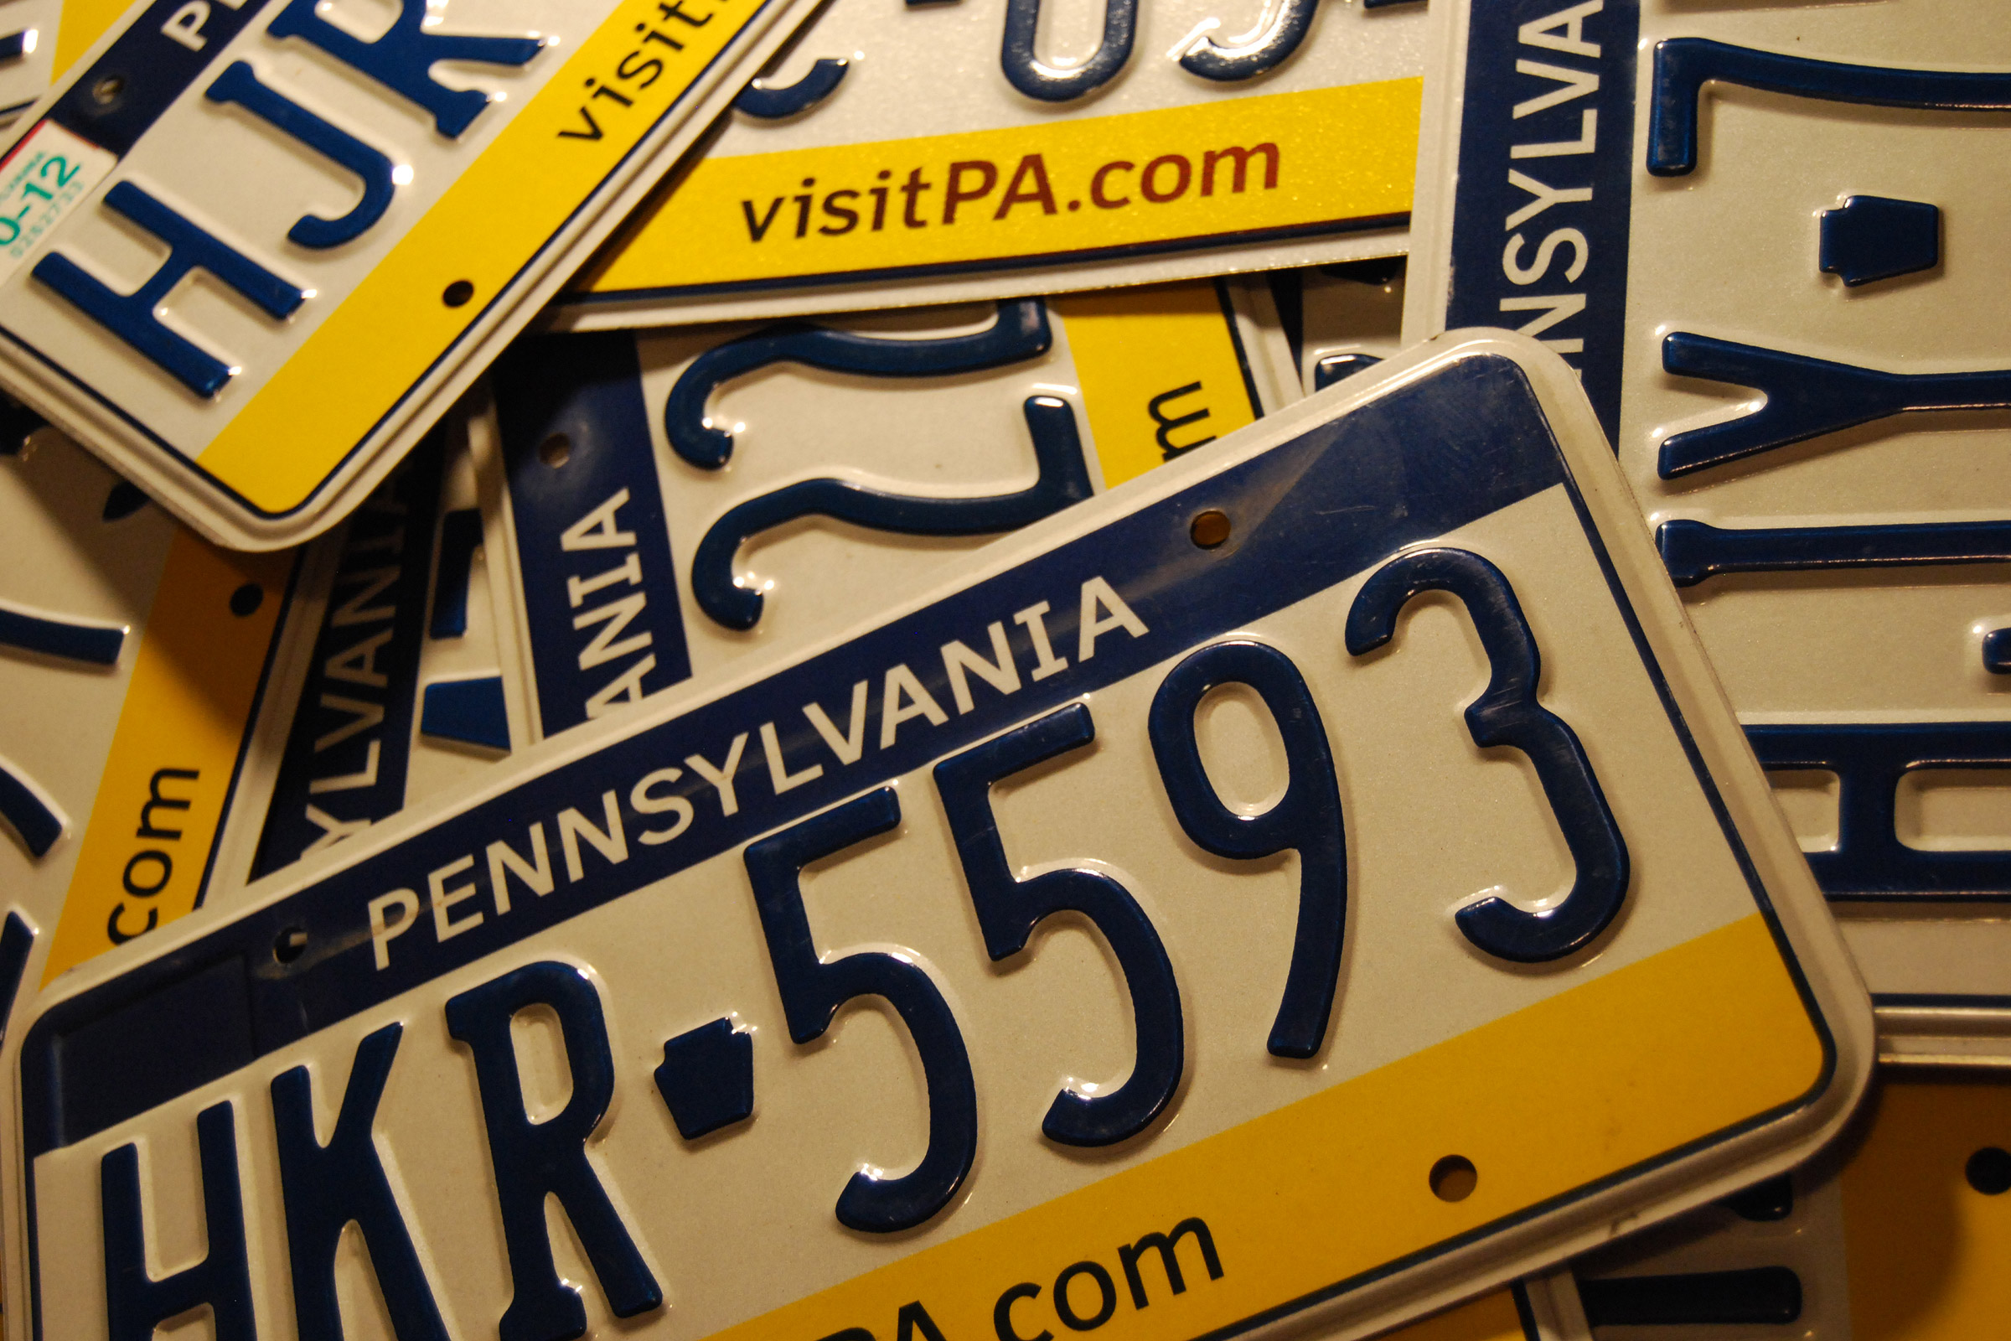
FUTURE ENHANCEMENTS
Vehicle Number Plate Recognition

Slide 25
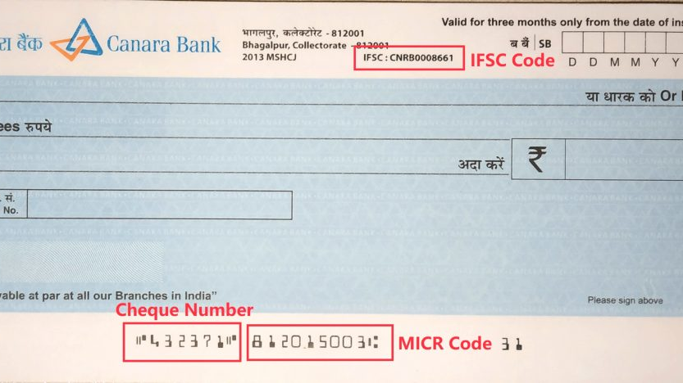
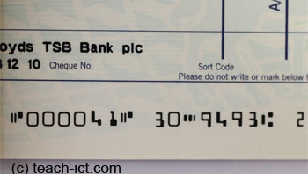
FUTURE ENHANCEMENTS
Bank Cheque Digit Identification

Slide 26
REFERENCES
https://www.geeksforgeeks.org/advantages-and-disadvantages-of-optical-character-reader-ocr/
https://www.youtube.com/watch?v=u3FLVbNn9Os
https://ijisrt.com/wp-content/uploads/2019/06/IJISRT19JU358.pdf
https://ieeexplore.ieee.org/document/9213482

Slide 27
THE END

